Slide 1

Interactive Earthquake Map
USGS – Earthquake observations last 7 days

Slide 2
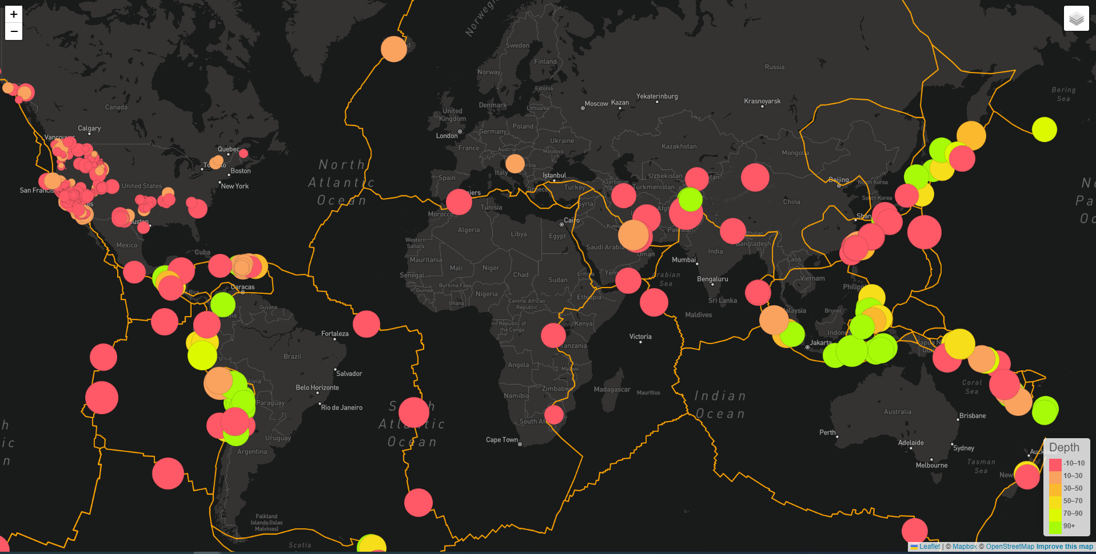

Slide 3
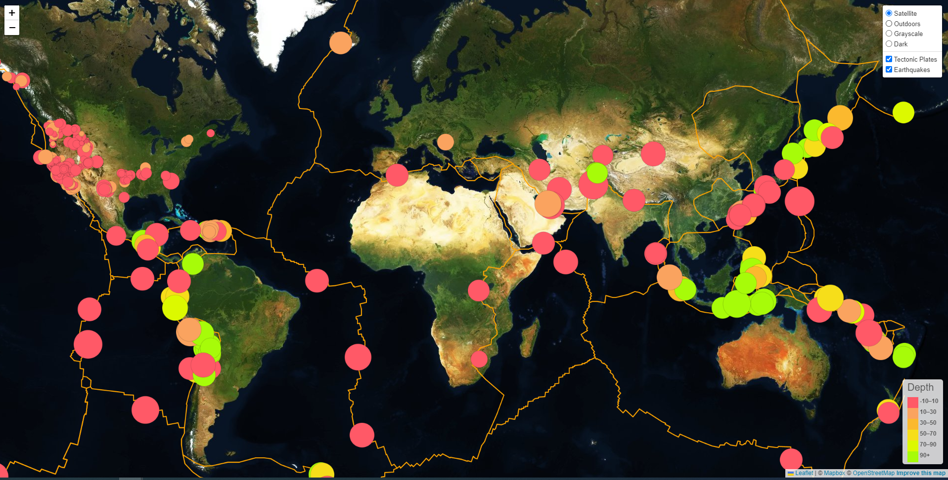

Slide 4
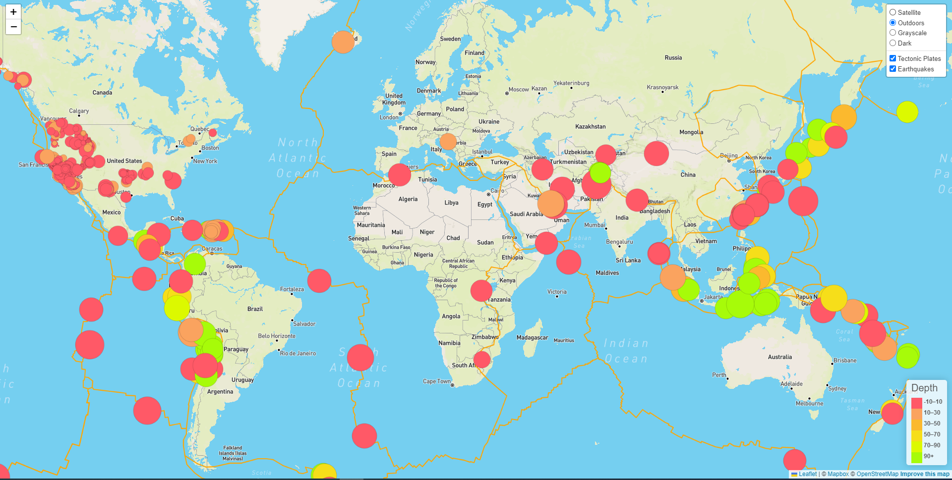

Slide 5
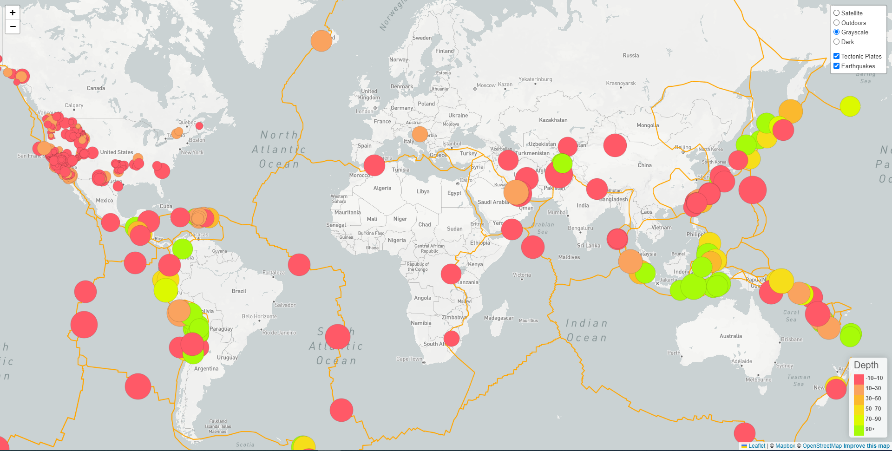

Slide 6
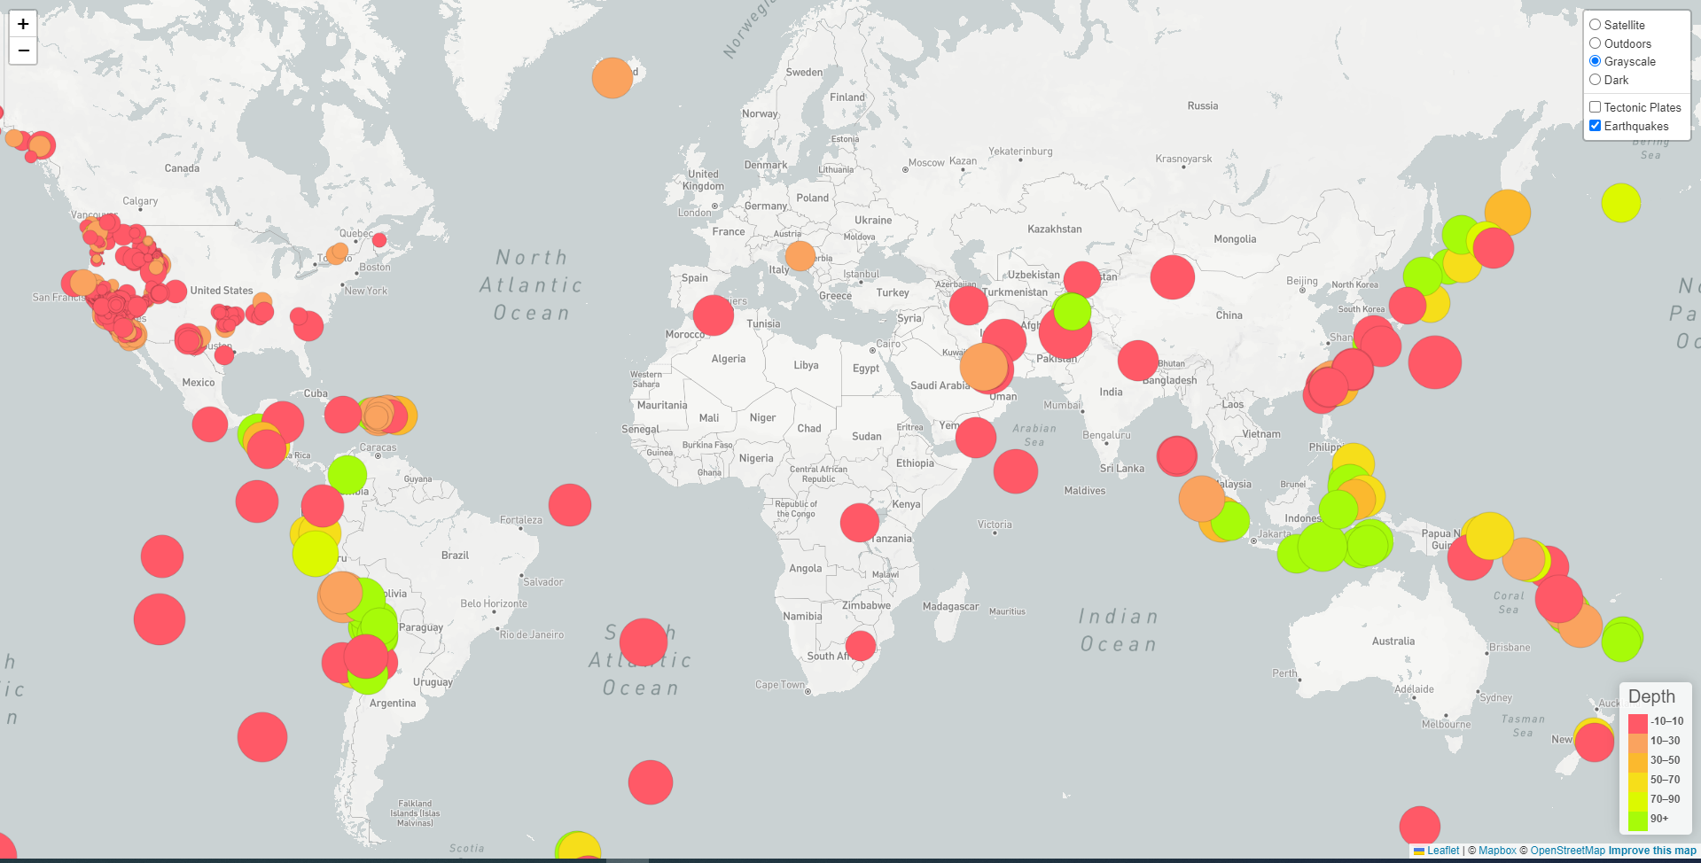

Slide 7
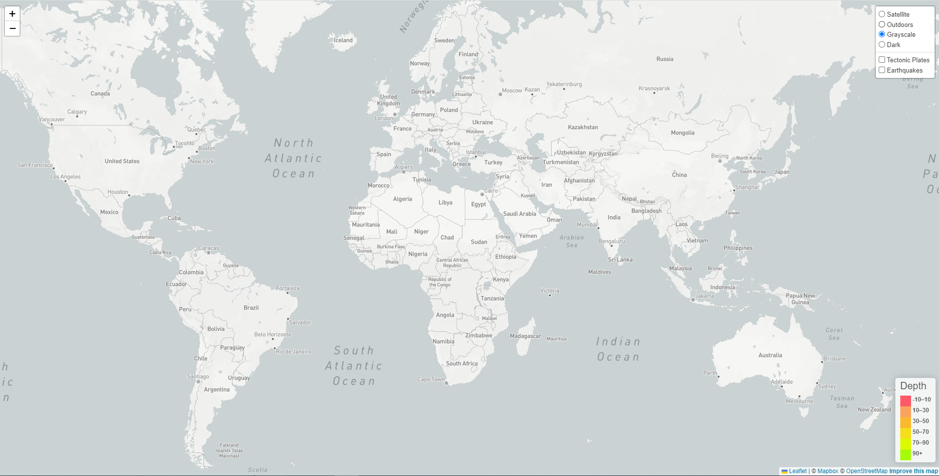

Slide 8
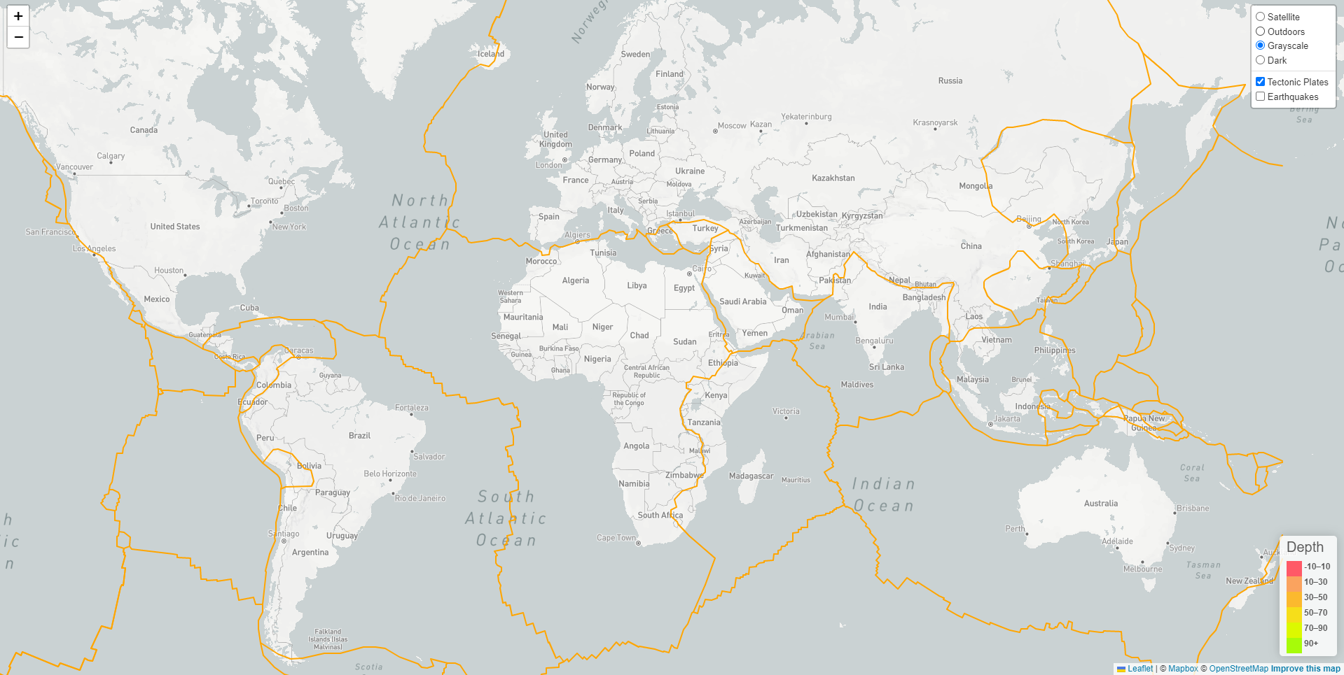

Slide 10
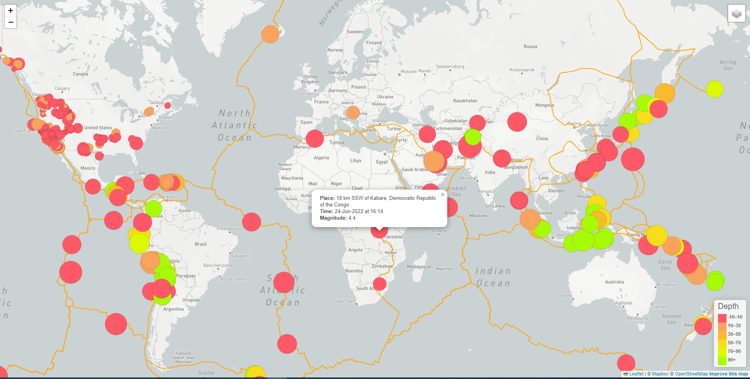

Slide 11
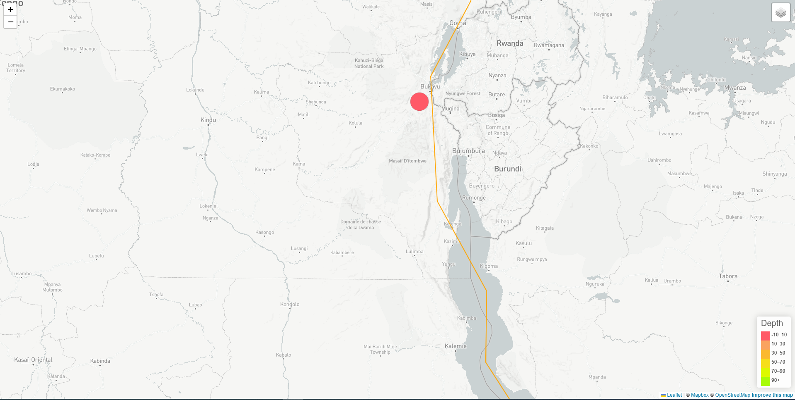

Slide 12
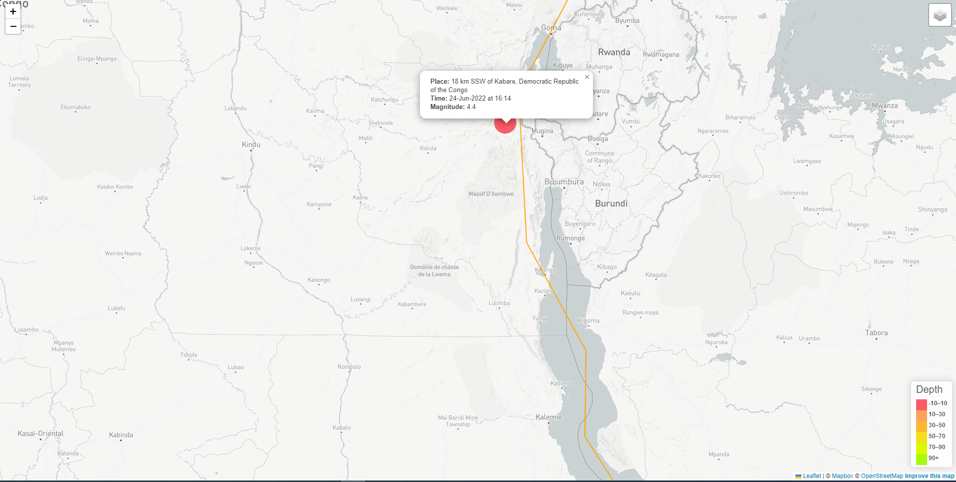

Slide 13
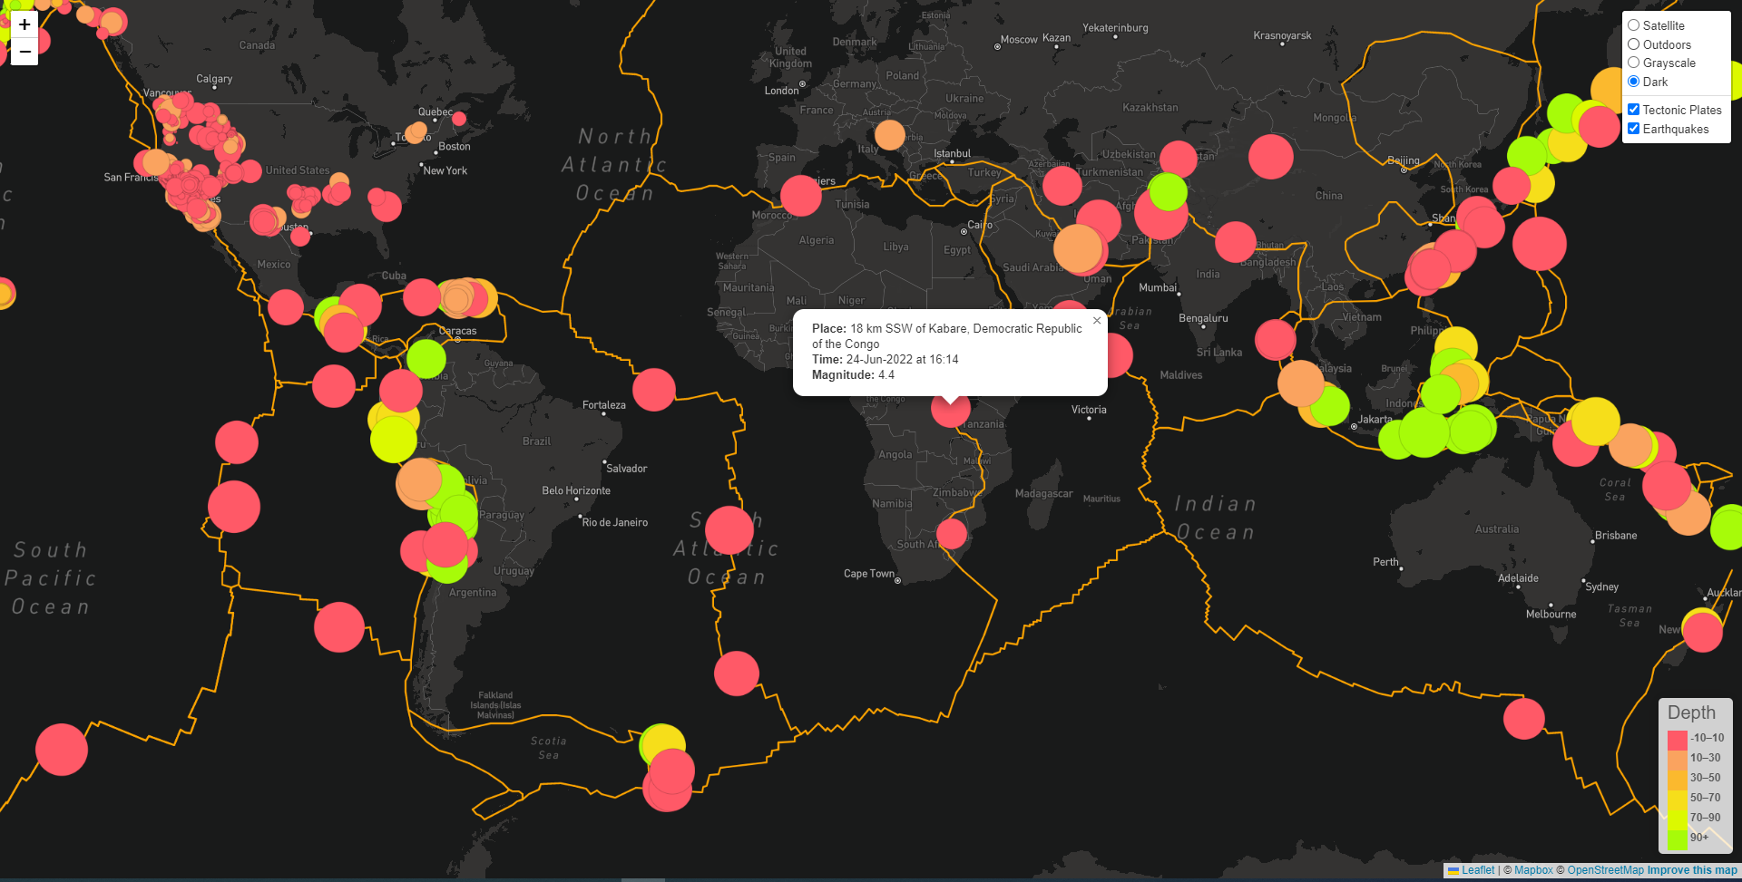

Slide 14
Thank You
Credits:
Leaflet|Mapbox|OpenStreetMap
USGS|raw.githubusercontent.com/fraxen/tectonicplates/master/GeoJSON/PB2002_boundaries.json

